Slide 1

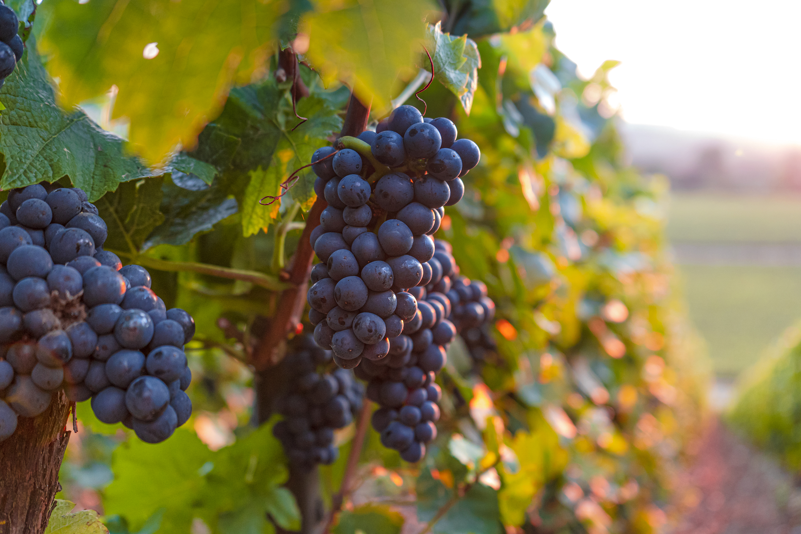

Wireless Microclimate System for Agrivoltaics
By: Da Boyz (Yueithony Roillex)

Slide 2
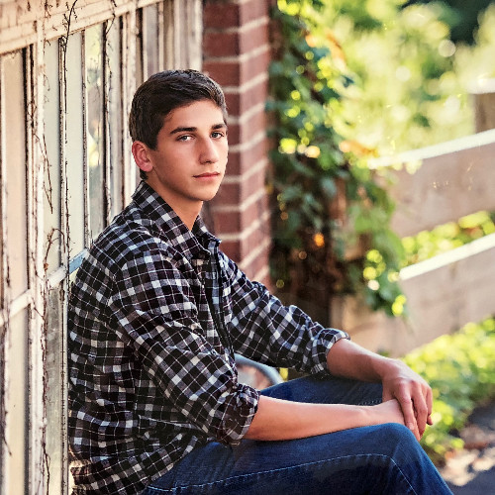
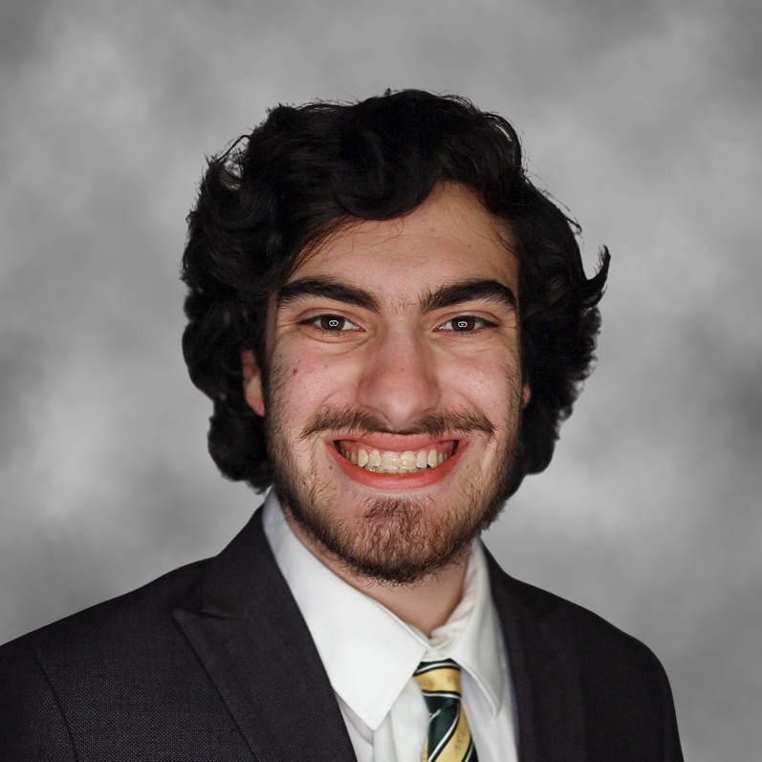
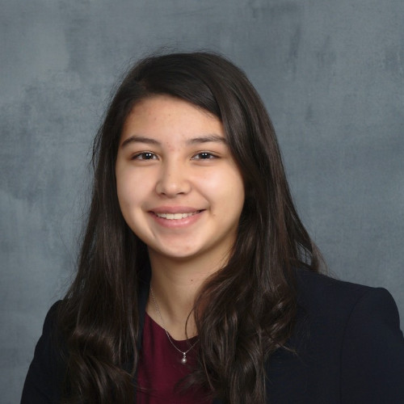



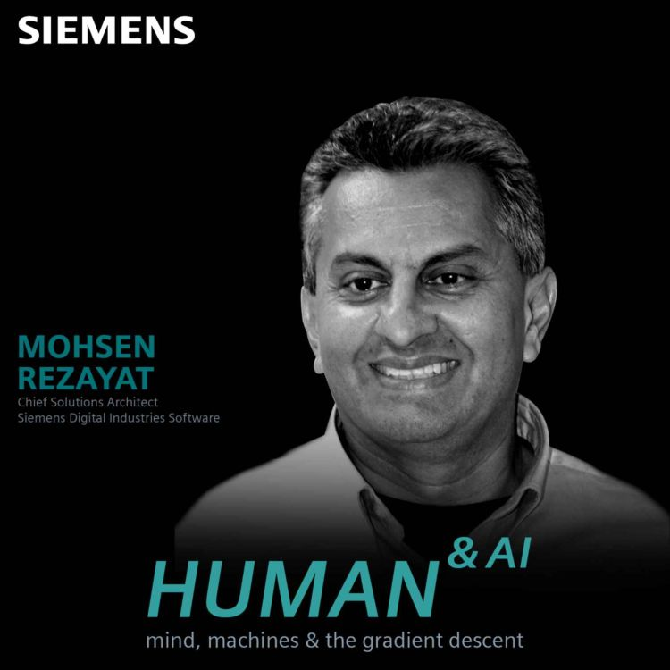
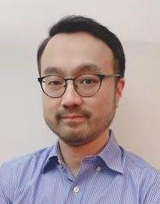
Team – Da Boyz (Yueithony Roillex)
Team Members
Alex Campbell – campb4ja@mail.uc.edu
Anthony Napolitano – napoliaj@mail.uc.edu
Rose Saalman – saalmark@mail.uc.edu
Keith Springs – springkh@mail.uc.edu
Yulia Martinez – martinyg@mail.uc.edu
Will Hopkins – hopkinwe@mail.uc.edu
Advisors
Dr. Mohsen Rezayat – mohsen.rezayat@omid-usa.org
Dr. Je-Hyeong Bahk – bahkjg@ucmail.uc.edu

Slide 3
Project Abstract
In this project, we will develop a wireless microclimate sensor system that is capable of sensing local climate components such as air temperature, humidity, light intensity and frost at an agricultural site as well as the soil conditions such as soil temperature and moisture level. These sensing data will be collected remotely into an application, made accessible to the user, and will be used to make automatic decisions on the adjustment of the PV panel angle and other operations. Some extreme weather events such as hails may not be easily detected or predicted from the microclimate sensing; these will instead be reported from public alert sources.

Slide 4
Goals
To collect meaningful data at the vineyard that includes temperature, humidity, light, rainfall, soil moisture and frost
Send the data to cloud to graph and visualize the data
Send graphs to an app that the farmer can use to analyze
Send alerts via the app to the user when hazardous conditions are met so the farmer can make preparations

Slide 5
Broader Impacts
Farmers can now get alerts can be prepared to save their crops which help feed a community
These alerts also help farmers save money on equipment, especially with frost detection and the supplies to combat frost
The data collected can be analyzed and help for predictability
This design will be open to the public, so other engineers can build upon and improve the current model

Slide 6
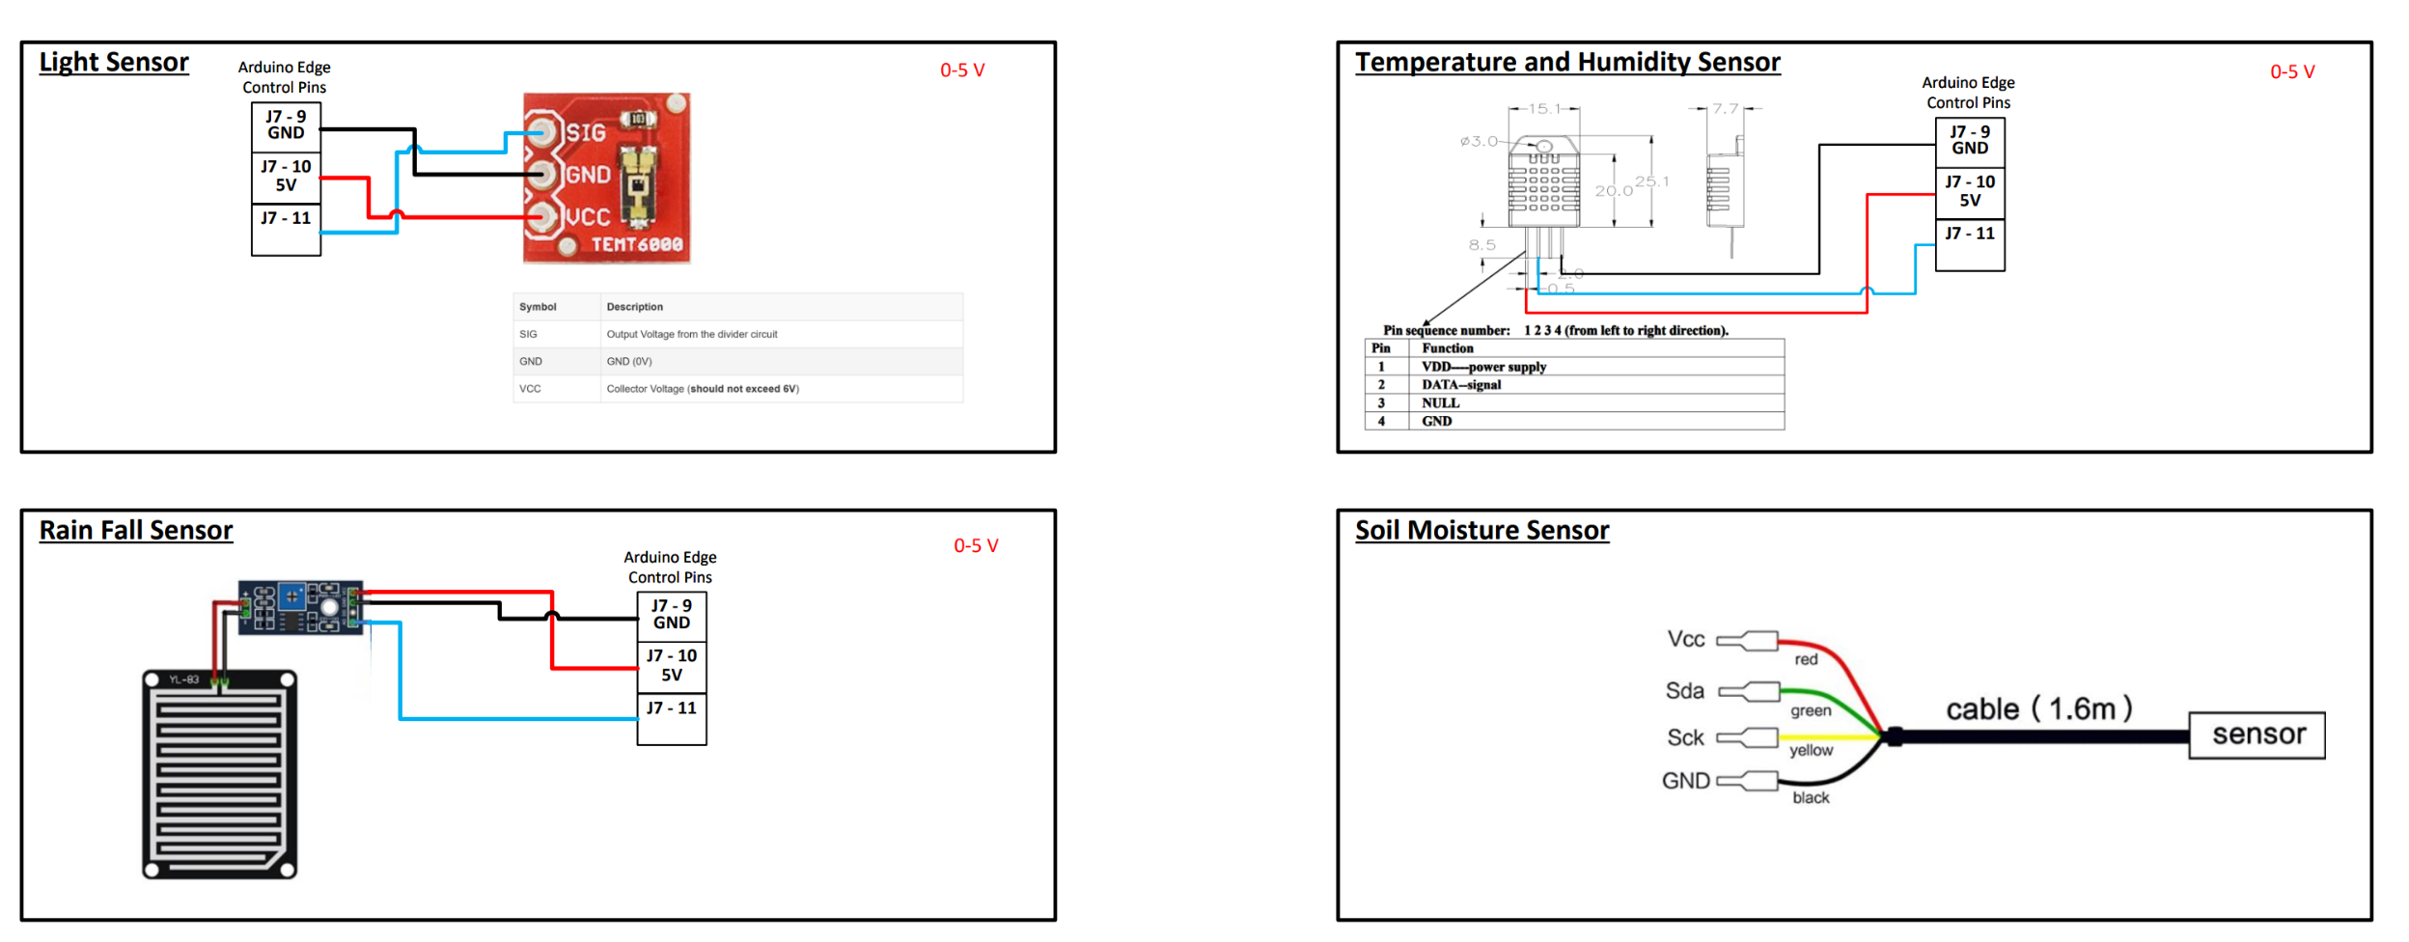
Design Specifications

Slide 7
Technologies
ESP32 Microcontrollers
DHT22 Temperature and Humidity Sensor
TEMP600 Ambient Light Sensor
YL-83 Rainfall Sensor
FS20-SHT10 Soil Moisture and Temperature Sensor
SF-110 Frost Sensor
Phone and Web Application to Display Collected Data Coded in Python

Slide 8
Milestones
Fall 2022 Semester: Researched microcontroller and sensors and application options, completed class assignments
January 2023: Begin app development and purchase microcontrollers and sensors
February 2023: Begin testing sensors with microcontrollers and send data to the app via InfluxDB
March 2023: Add filtering and alert functionality to app, continue implementing sensor system
April 2023: Build small scale sensor system for expo, implement sensor system at vineyard after expo

Slide 9
Results
Meaningful data was collected using our microcontrollers and sensors
Data was pushed with wireless communication
App was developed that displays data along with filters to be implemented at multiple zones and sites in the future
Complete sensor system was designed to automate data collection and push to the app for the user to analyze

Slide 10
Challenges
Implementing the clock cycle for the soil moisture sensor
Researching ways to protect the hardware once installed at the vineyard
Pushing data to InfluxDB and then to the app
Developing app to be multiplatform

